Slide 1
Occupancy Manual
Bob Andrews Sections

Slide 2
Faxes
There will be a very limited number of traditional fax machines used only in areas where electronic faxing is not possible.
Most faxing will be done using RightFax
Faxes will be received into an electronic inbox
Faxes can be read on-line and optionally saved or printed
Outbound faxing will be done by scanning and sending using the RightFax application
The Electronic Health Record (Sutter eHR) will fax records automatically as required by clinical workflows.

Slide 3
Multi-Function Printers (Scan, Print, Copy)
Multi-function networked printers are located throughout the facility and can function as copiers, scanners and printers.
Print jobs can be retrieved by tapping your badge on the sensor located on the printer of your choice.
Some workflows will default to specific printers (e.g., in the ED)
Copier and printer support is provided by the Sutter Health Service Desk which is accessed by calling 888-888-6044 or accessing the IS Portal at IS.SUTTERHEALTH.ORG.

Slide 4
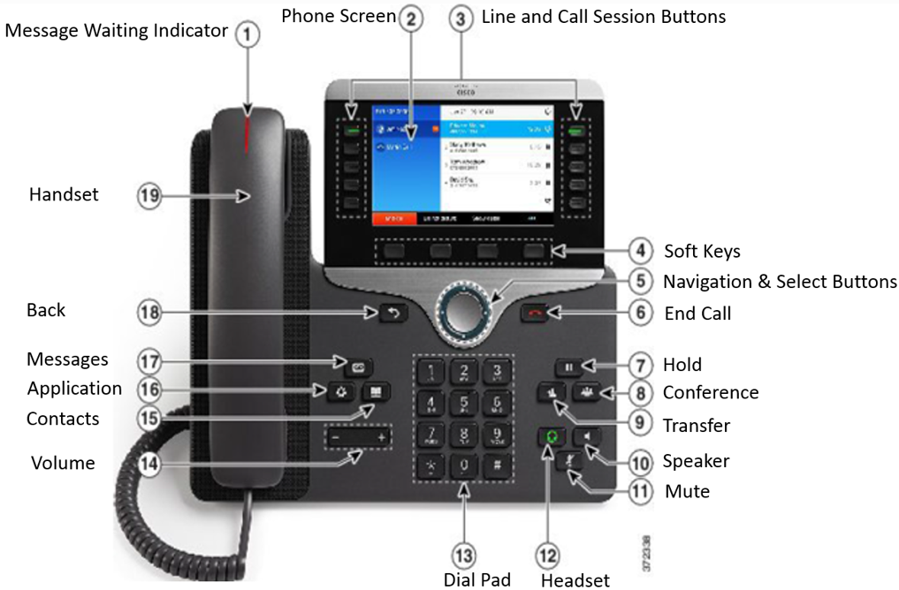
Telephone System
Cisco Voice over IP (VoIP) infrastructure desk, wall and wireless phones.
Cisco Unity Voice mail
All traditional phone features such as on hold, speaker phone, call forwarding, and conferencing
Connects to the Vocera application so that calls can be make between telephones and Vocera badges.
Informacast for paging and broadcast messaging
Emergency red phones will be installed in key locations

Slide 5
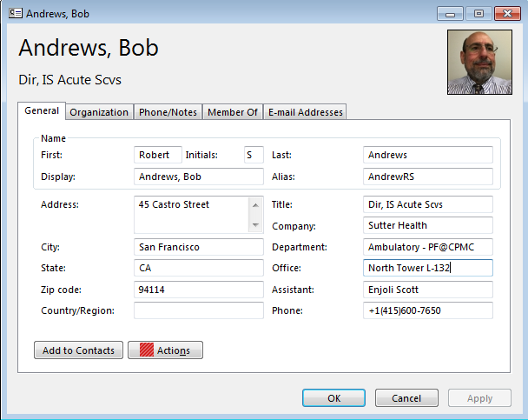
Department Phone Directories
We will be using the Microsoft Outlook Address Book as the department phone directory for all CPMC Campuses.
The normal processes for adding / changing staff locations will synchronize with the address book to keep the directory accurate without additional administrative work.
Advanced searching on any of the address book fields is possible for quick lookups.

Slide 6
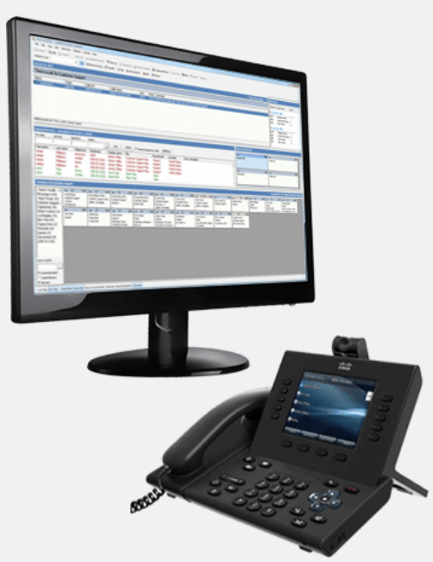
PBX System
PBX Operators will be located at both the Van Ness and Mission Bernal Campuses.
Vista Point Enterprise Operator Services System will support the PBX operator workflows and assist in the management of call queues, routing and call handling statistics.
PBX operators will have Nurse Call and other alarm panels at their stations to assist in routing of alerts.

Slide 7
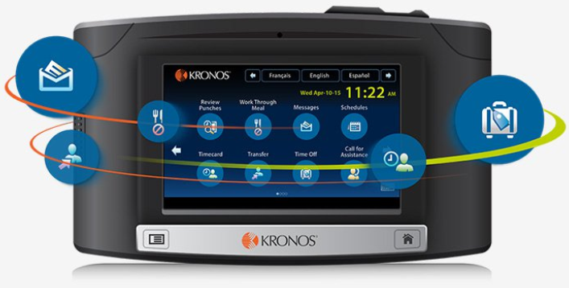
Kronos Time Clocks
New InTouch Wall Clocks
Conveniently Positioned
Elevator Lobbies
Main Corridors
Lab & Pharmacy
Some Staff Lounges
Web Application will also be available for some users

Slide 8
Patient Entertainment / Education (Sonifi)
Full complement of TV Programming
View Assigned Educational Content
Complete questionnaires
Order patient meals
View care team information
Access patient schedule
Interact with their care team
Controls and Volume Integrated Into Pillow Speaker

Slide 9
Digital Signage
All nurse stations will have digital display boards to display patient census
Specialized display boards will also be present in the ORs and Emergency Department
Conference rooms will have digital signs indicating the daily schedule
A digital donor wall will be present in the lobby areas
Electronic informational kiosks will be located at main patient entrances to facilitate wayfinding
The cafeteria will have digital signs displaying the daily menu

